Slide 1
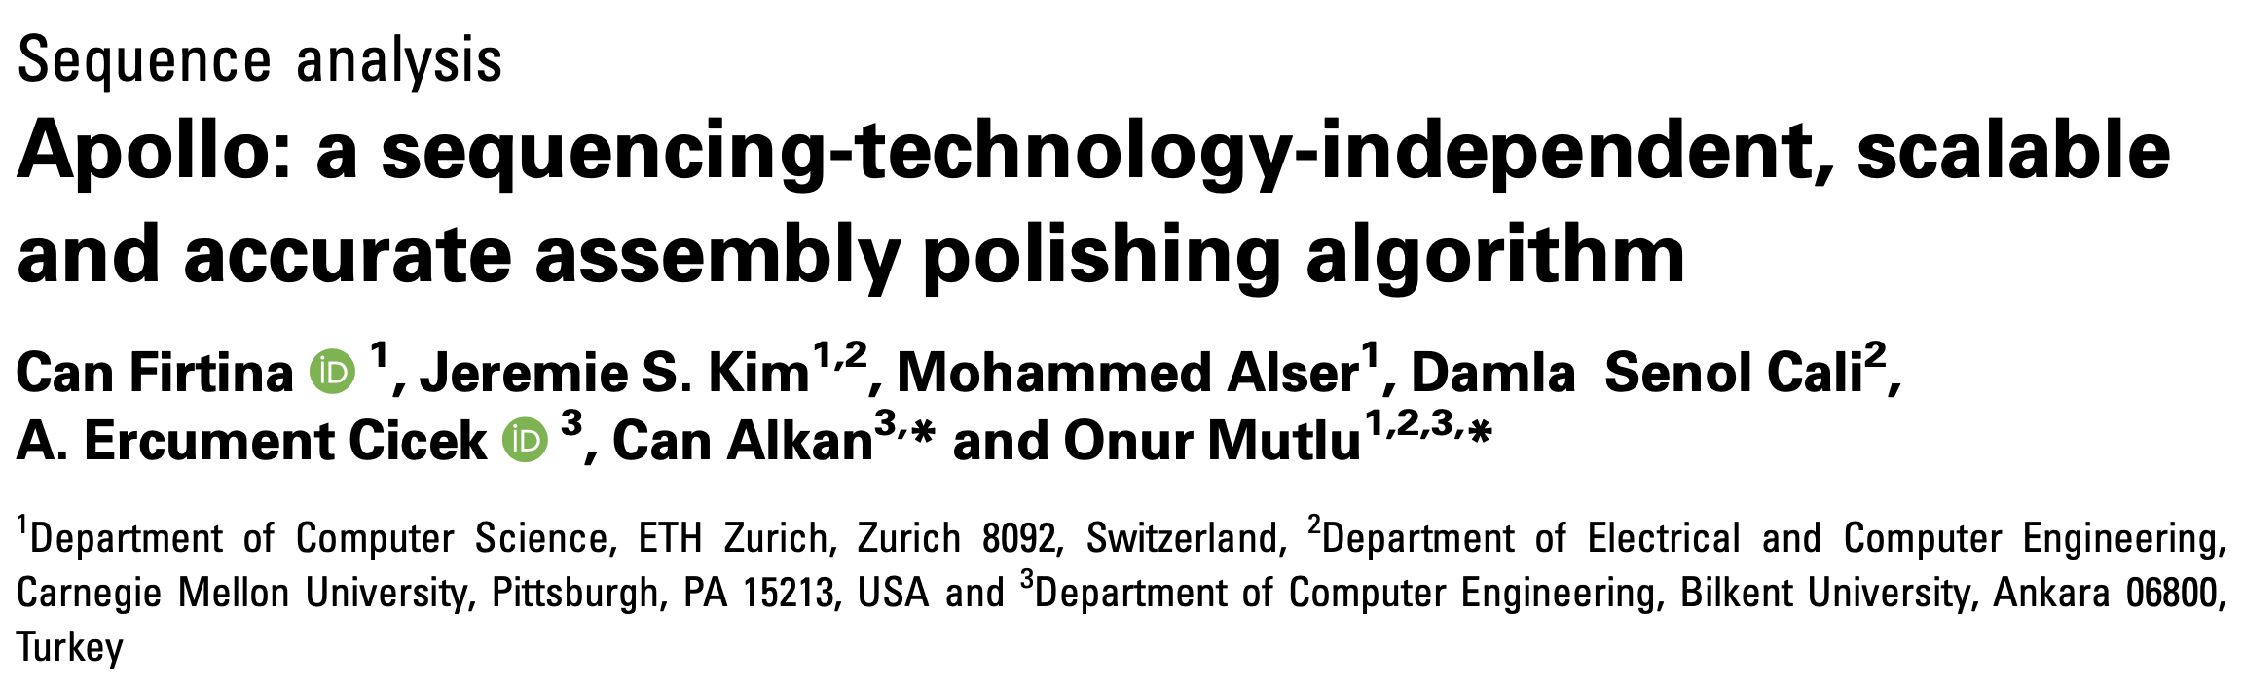
ExaBiome/PASSION/SAFARI Workshop on Architectures and HPC for Genomics
Can Firtina
May 26th, 2021
Notes:
Hello everyone. I am Can. I am a PhD student in SAFARI at ETH Zurich. I will be presenting our paper, Apollo, which is an assembly polishing algorithm to correct the errors in assemblies. This paper is published in the Bioinformatics journal last year.

Slide 2
Executive Summary
Problem:
Long read de-novo assembly is inherently erroneous
Existing assembly polishing techniques cannot adapt to varying sequencing technologies and do not scale well for large genomes
Goal: Propose a technology-independent and scalable assembly polishing algorithm -- Apollo
Key Ideas:
Align reads to the erroneous contigs from the same sample
Construct a profile hidden Markov model (pHMM) for each contig
Use the read-to-contig alignments to update the parameters of pHMMs
Decode the consensus string from the updated pHMM to generate the corrected contig
Results/Observations
Apollo is the only assembly polishing that is scalable to polish large genomes given the limited memory constraints (e.g., 192GB)
Apollo constructs the most reliable assemblies when hybrid set of reads (e.g., Illumina and PacBio) are used in a single run compared to other polishing tools
Apollo is ~25x slower on average (up to ~600x) than other polishers
Notes:
Let's start with the executive summary of the paper. De-novo assemblies constructed using erroneous long reads potentially include the errors propagated from long reads. There are some assembly polishing tools that aim to correct (in other words: polish) these errors. However, these existing tools are not flexible to adapt to varying error profiles of different sequencing technologies and they have a high memory-footprint when polishing large genomes such as a human genome.
[CLICK]
Our goal is to propose a flexible and scalable assembly polishing algorithm. To this end we propose Apollo.
[CLICK]
Apollo is mainly composed of four key ideas. First, we re-align the same reads that are used to construct the assembly (and any other additional reads) to contigs of the assembly. Second, we construct a profile hidden Markov model graph for each contig to use the graph as a probabilistic model of the contig. Third, we use the alignment information from the first step to update the probabilities in the pHMM graph (this is basically the training step). Fourth, we decode the consensus string from the graph after processing all alignments which would potentially reveal the corrected contig.
[CLICK]
We show three key results. First, Apollo is the only polishing algorithm that can polish large genomes given the memory constraints used in our experiments (192GB). Second, Apollo constructs the most reliable assemblies when both long reads and Illumina reads from the same sample are available for polishing. Third, Apollo performs worse than most of the other polishing tools due to its computationally expensive training and inference steps.

Slide 3
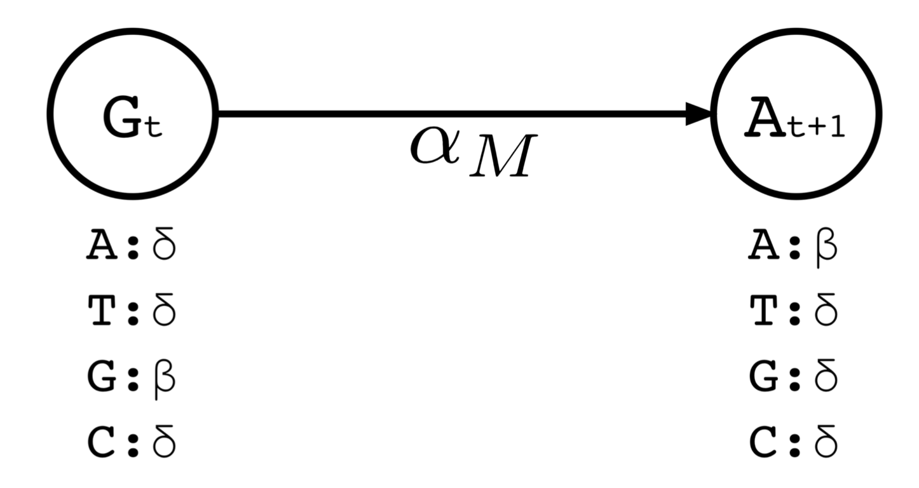
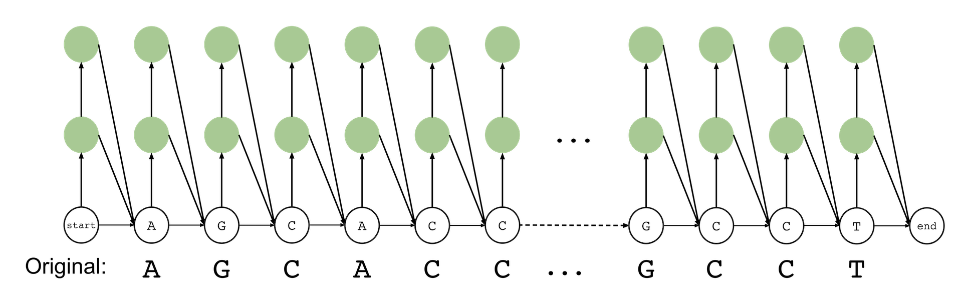
Profile Hidden Markov Models (pHMMs)
Three components:
States
Transitions (directed edges)
Emissions
Modification roles and probabilities are assigned to states
Substitution, insertion, deletion, or match (no modification)
A group of states to perform all modifications probabilistically on/after each character of a contig
Notes:
Let me give you a very brief overview of profile hidden Markov models (or pHMMs). A pHMM represents a probabilistic model of its underlying sequence of characters (or in our case contigs) with all the potential modifications. A pHMM is basically a graph and it mainly includes three components: states, directed edges (transitions) and emissions.
[CLICK]
States have certain modification roles such as inserting or deleting a character, performing substitution or making no change at all. All these operations are governed by the probabilities assigned for emissions and transitions.
[CLICK]
A pHMM includes a group of distinct states for every character of the underlying contig where transition and emission probabilities are assigned based on the character at a position.
[CLICK]
In this example, a group of states would be these three states with certain probabilities for the character C at position 3 of a contig.

Slide 4
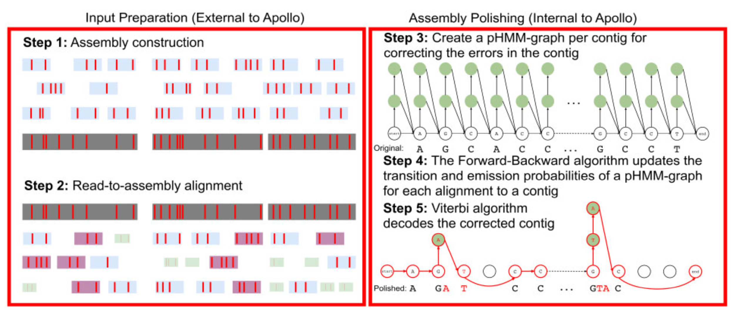
Apollo Workflow
Step1: An assembler uses erroneous long reads to construct contigs
Step2: We re-align the same reads (and additional reads) to contigs
Steps 3-5: Apollo uses pHMMs to decode the consensus of alignments for a contig, which potentially eliminates majority of errors
Notes:
So how do we use pHMMs in Apollo. I will describe you the workflow to polish an assembly from scratch when using Apollo. Assembly polishing mainly includes five steps. Apollo outsources first two steps and the last three steps are performed by Apollo.
[CLICK]
First, we use an assembler to construct the contigs from erroneous long reads. Here the red tiny rectangles would represent the errors where you can see some of these errors may propagate to the contigs generated by the assembler as shown below (dark gray rectangles).
[CLICK]
We re-align these erroneous long reads and any other additional reads (rectangles in different sizes and colors) to contigs. Here the idea is to use contigs as a backbone, which did not exist when generating de-novo assemblies. We assume a reference-based alignment would potentially generate more reliable alignment results than the overlap finding.
[CLICK]
We generate the pHMMs for each contig.
Here in Step 4, we use the alignment information generated in the second step to update the parameters of pHMMs. There are certain expectation-maximization algorithms such as the Baum-Welch algorithm that would update the parameters based on the read alignments. This step can be considered as the training step in Apollo.
[CLICK]
We decode (or infer) the consensus string from the pHMM graph after the training step is complete. The consensus string would reveal the modifications that need to be made, which we refer to it as error correction or assembly polishing.

Slide 5
Key Results
State-of-the-art polishing tools: Racon, Pilon, Quiver, Nanopolish
Scalability of polishing algorithms for a human genome
PacBio (35x and 8.9x) and Illumina (22x)
Racon, Pilon and Quiver exceeds memory requirements (192GB) when using high/medium coverage PacBio/Illumina reads
Apollo is the only algorithm that is scalable to polish large contigs given the memory constraints
Pipeline to construct the most reliable contigs
Canu assembler rather than Miniasm
Polish using both long and Illumina reads (i.e., hybrid reads)
Apollo to use hybrid reads
It can use multiple read sets in a single run
Apollo performs better than Nanopolish (~2-5x) but worse than Racon, Pilon, and Quiver (up to 600x, on average ~20-25x)
Notes:
I will briefly share the key results we show in the paper. We compared Apollo to the state-of-the-art assembly polishing tools such as Racon, Pilon, Quiver, and Nanopolish. Nanopolish also uses profile hidden Markov models to calculate the probability of Nanopore events given a sequence.
[CLICK]
First, we show the scalability results when polishing a human genome. We use PacBio reads with 35X and 9X coverage and Illumina reads with 22X coverage. We show that the polishing algorithms cannot complete polishing given the memory constraints we have as they require more than 192GB of memory. We show Apollo is the only algorithm that scales well to polish large genomes as it uses around 60GB of memory to perform the same polishing.
[CLICK]
Second, we also reveal the optimal pipeline that generates the most reliable assemblies from long reads. We show the Canu assembler is preferable compared to Miniasm when construcing the assembly. Furthermore, we show that using hybrid set of reads improves the accuracy of any assembly polishing tool. Last, Apollo constructs the most reliable assemblies when Canu and hybrid reads are used.
[CLICK]
Third, Apollo performs better than another pHMM-based tool, Nanopolish, but much worse than other polishing algorithms that rely on simple heuristics rather than expensive training and inference steps.

Slide 6
Future Work
Apollo performs worse due to its computationally expensive parameter update (training) and decoding (inference) steps
Both training and inference steps are based on embarrassingly parallel algorithms
CPU cannot utilize all available parallelism
We implemented the training step in GPUs and observe that we can achieve around 45x performance improvement compared to the CPU
Can we do better? Hardware acceleration for training?
Combining training and inference steps in an accelerator would potentially provide even better performance improvements
A generic pHMM accelerator rather than focusing only on Apollo
Parameter optimizations for different sequencing technologies to improve sensitivity
Notes:
I will lastly present you the potential future work based on what we observe from Apollo. As stated earlier, Apollo performs worse than most of the polishing tools mainly due to the training and inference steps. We observe that these training and inference steps are based on embarrassingly parallel algorithms where each state can be processed independently among thousands of states.
[CLICK]
However, CPUs cannot utilize all the available parallelism that the algorithms provide
[CLICK]
We implemented the training step in GPUs and observe a significant speed up up to 45X when the states are processed in parallel.
We can potentially do better if we optimize the hardware and software together to design a hardware accelerator.
Recently we submitted such a work that accelerates the training step in pHMMs
[CLICK]
A potential future work would be combining the inference step with the training step in a hardware accelerator to utilize all available parallelism in both steps.
[CLICK]
Another implementation-based future work would focus on optimizing the parameters such as probabilities in pHMMs for different sequencing technologies as Apollo is flexible to perform all these parameter changes.

Slide 7
Executive Summary
Problem:
Long read de-novo assembly is inherently erroneous
Existing assembly polishing techniques cannot adapt to varying sequencing technologies and do not scale well for large genomes
Goal: Propose a technology-independent and scalable assembly polishing algorithm -- Apollo
Key Ideas:
Align reads to the erroneous contigs from the same sample
Construct a profile hidden Markov model (pHMM) for each contig
Use the read-to-contig alignments to update the parameters of pHMMs
Decode the consensus string from the updated pHMM to generate the corrected contig
Results/Observations
Apollo is the only assembly polishing that is scalable to polish large genomes given the limited memory constraints (e.g., 192GB)
Apollo constructs the most reliable assemblies when hybrid set of reads (e.g., Illumina and PacBio) are used in a single run compared to other polishing tools
Apollo is ~25x slower on average (up to ~600x) than other polishers
Notes:
That’s all I want to present about Apollo and thank you for listening.

Slide 8
Backup Slides
8

Slide 9
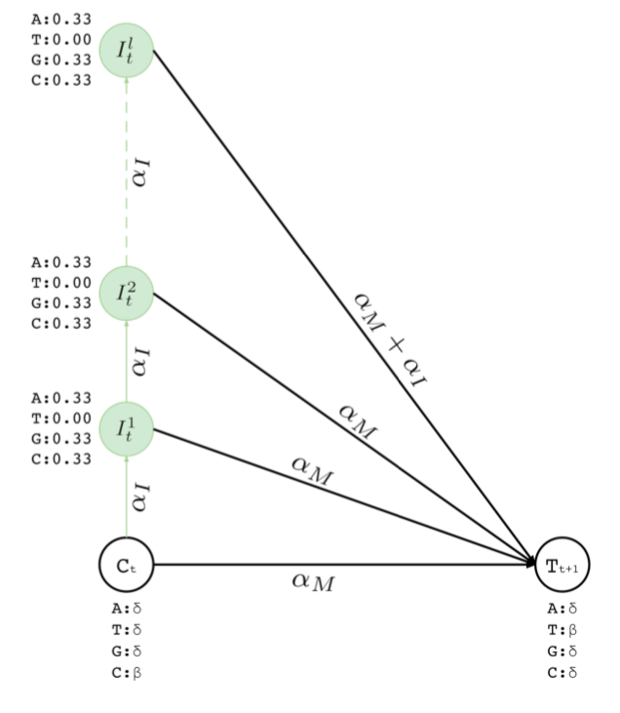
Resolving deletion errors
Insertion states to insert at most l many bases between two bases in a contig
To insert “GC” between ”CT”
Visit match state at position t and emit C
Visit first insertion state after position t and emit G with deletion error probability
Visit second insertion state and emit C with deletion error probability
From second insertion state visit match state at position t+1 and emit T
Resulting sequence “CGCT”
Maximum number of insertions is a parameter to Apollo

Slide 10
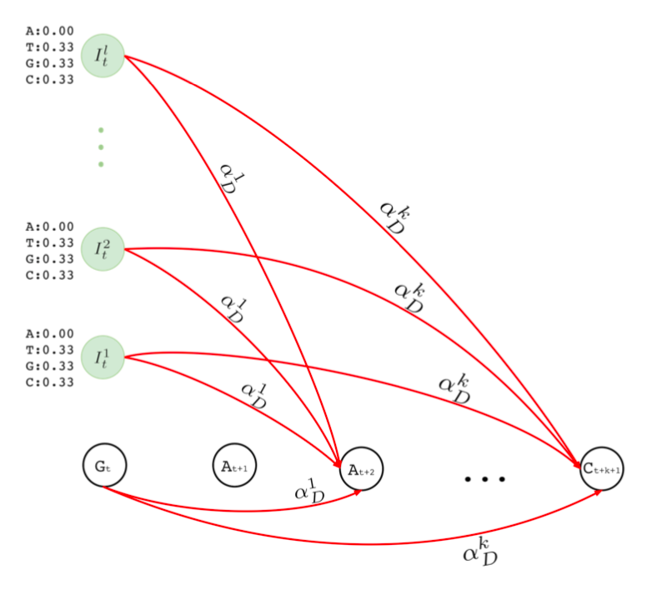
Resolving insertion errors
Deletion transitions to delete one or many bases in a row
To delete the first A in “GAA”
Visit match state at position t and emit G
Visit match state at position t+2 and emit A with single insertion error probability
Resulting sequence: “GA”
Having single or more deletions in a row may not be necessarily equally likely
Maximum number of deletions in a row is a parameter to Apollo

Slide 11
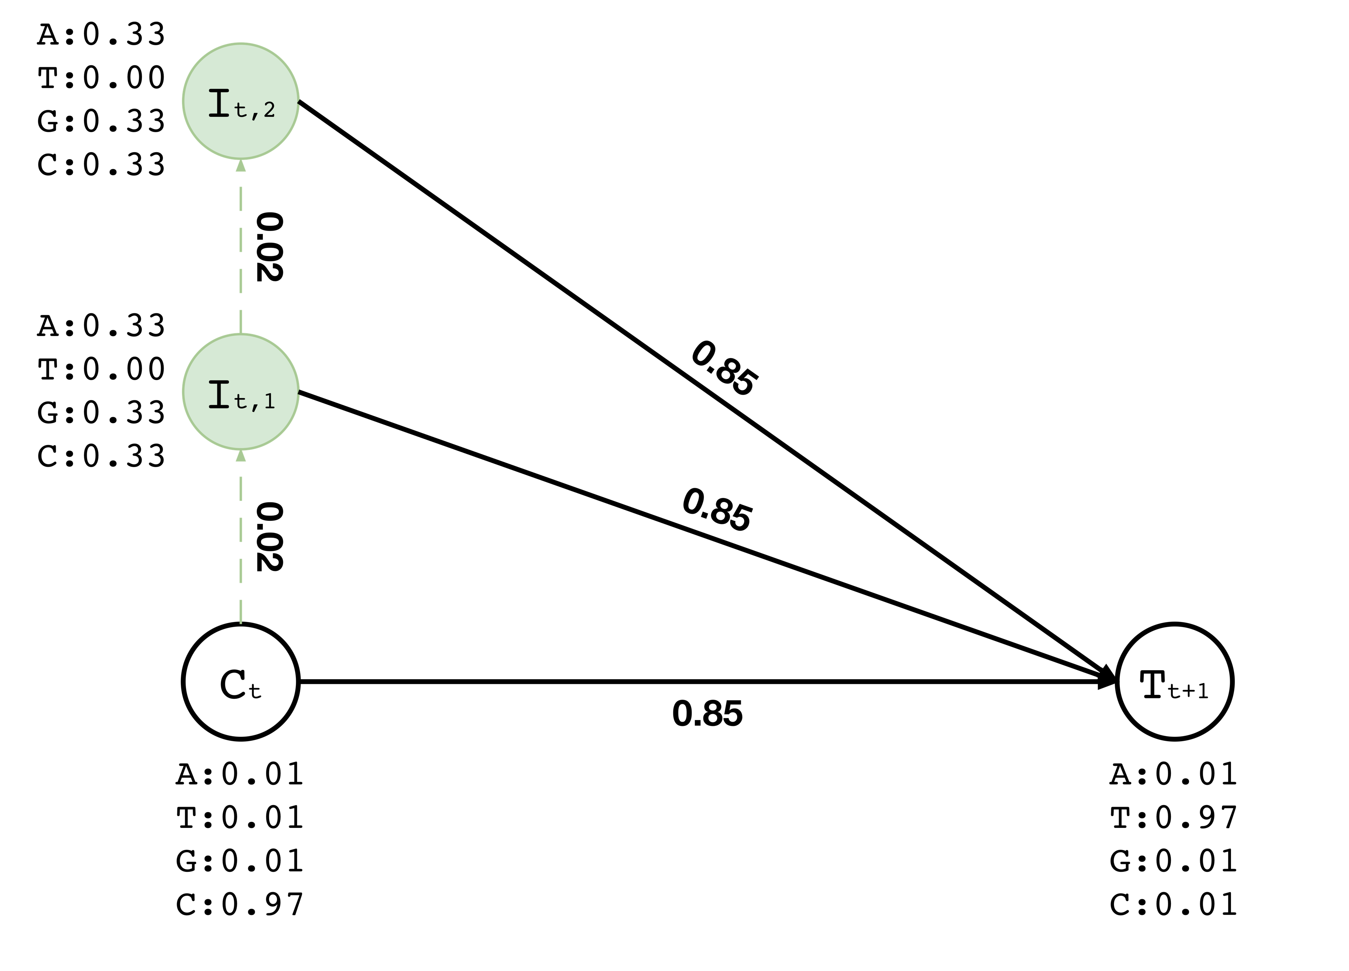
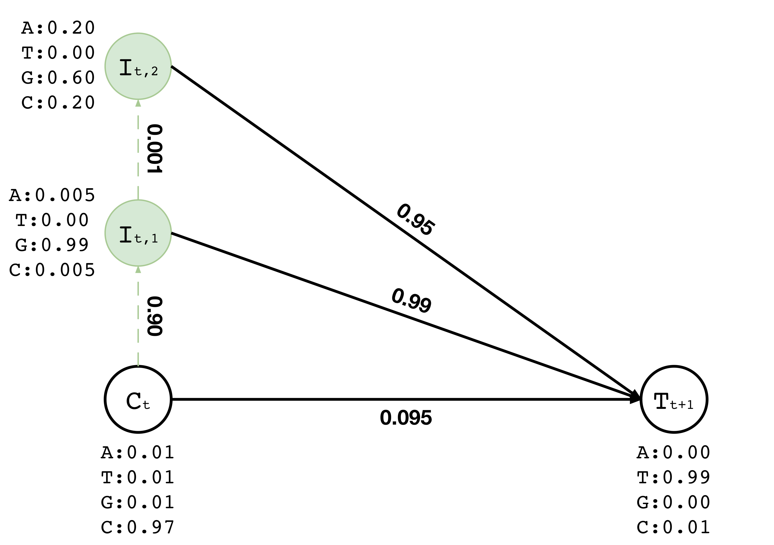

Training
Training data:
Read aligned to the location t of a contig
Assume we have the read “CGT” aligned to location t
After training the corresponding region of the graph we would expect change in the probabilities so that it will be likely to emit “CGT” somehow
CGT

Slide 12
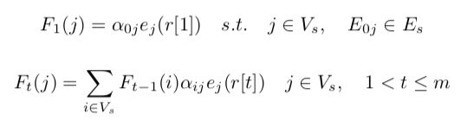
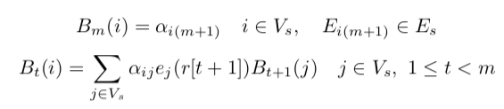
The Forward-Backward algorithm
Calculating the likelihood of visiting a state to emit a certain character of a given sequence (i.e., aligned read)
Forward calculation (F)
Backward calculation (B)
Backward calculation needs a starting point

Slide 13
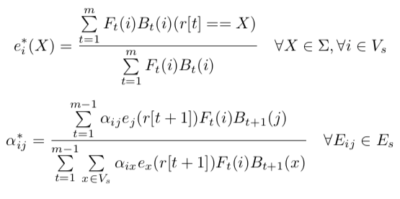
Training: The Baum-Welch algorithm
Expectation maximization step using the Baum-Welch algorithm
If there are multiple reads aligning to same region, we have multiple F(i) for a position t
Take the average and use it as F(i) for position t

Slide 14
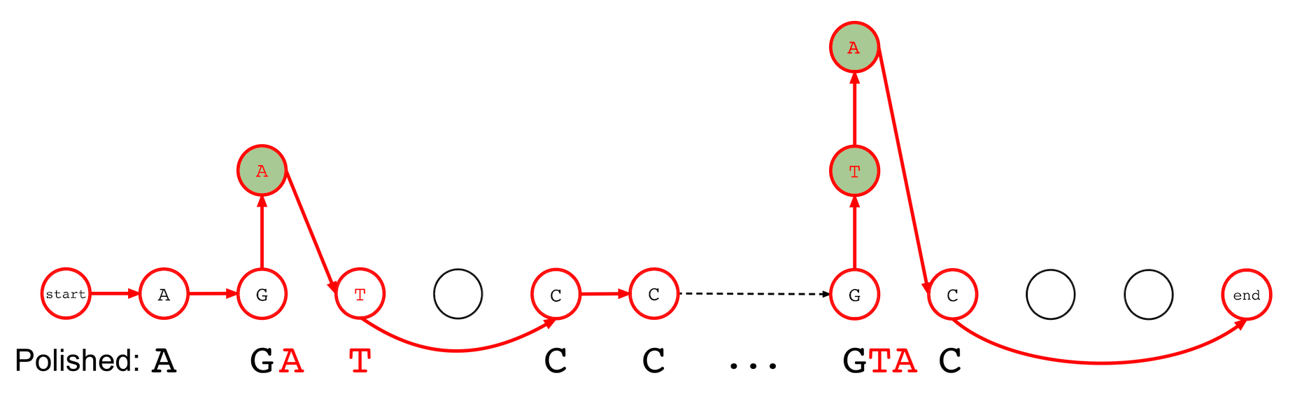
Inference: The Viterbi algorithm
Our original contig before polishing was: “AGCACC…GCCT”
After updating the probabilities, the most likely path from start to end reveals the corrected contig: “AGATCC…GTAC”

Slide 15
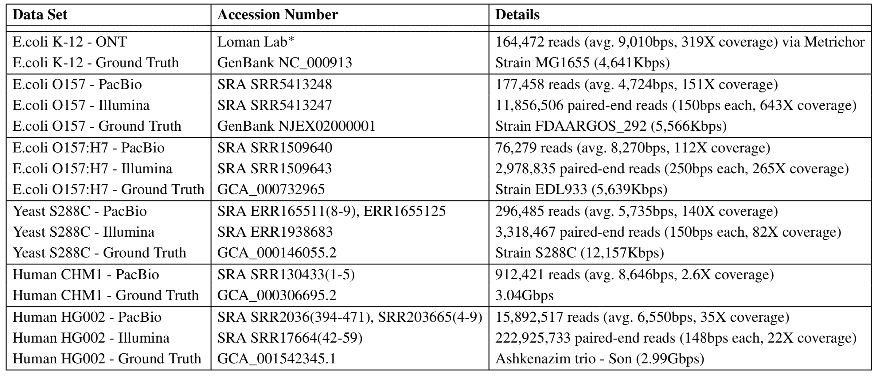
Data Sets

Slide 16
Experimental Setup
CPU: Intel®Xeon®Gold 5118 CPU @ 2.30GHz
24 cores (2 threads per core)
Max memory: 192GB
Assigned 45 threads to all tools
Apollo was compared with the state-of-the-art polishing tools
Racon, Pilon, Quiver, Nanopolish

Slide 17
Title
Text

